Slide 1
Predicting sales success from INTRO callS
Mikiko Bazeley
March 2019
Springboard Data Science Cohort
GH: https://github.com/MMBazel/springboard-program/tree/master/capstone1

Slide 2
Contents
Project Overview
Data Acquisition & Processing
Feature Engineering & Selection
Model Selection & Performance
Take-Aways
Data Overview

Slide 3
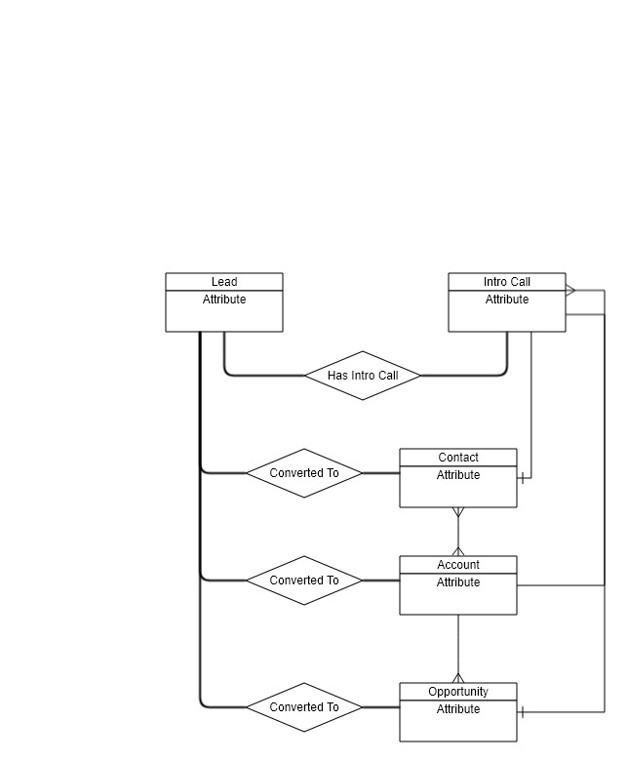
I. Project Overview
Goal:
Predict qualification of sales demo calls using lead and demo call data.
Potential Interested Parties:
Current company sales leadership
Current company marketing leadership
Other revenue operations professionals wanting to understand how to conduct similar analysis & projects
Data Source:
Internal AWS Redshift data warehouse with tables mirroring Salesforce objects & fields
Outcome:
Create classification model that predicts outcome of demo calls.

Slide 4

II. Data Overview
Origin:
AWS Redshift Database that collects data from all areas of the company (Salesforce, ADP, JIRA, Google Analytics, etc)
Additional Details:
Each row in the Intro Call table represents a single instance of a call but multiple rows in the Lead table could represent a single person, however, only a single Lead record will be attached to an Intro Call record.
For this project, used data from Jan 1, 2016 to Jan 1, 2019
Of 22.9K Intro Call records, 12.8K (56%) were qualified vs 10K (44%) disqualified indicating fairly well balanced classes
Leads Table/Object Volume: ~50K Columns: ~107 | Intro Call Table/Custom Object Volume: ~23K Columns: 114
Id First Name Last Name Company Job Title Email Landing Page etc | Id Lead Id Lead Name Company Name Assigned to Created Date Scheduled Call Date etc

Slide 5
III. Data Acquisition & Processing
Important considerations needed to be handled given the data quality & source:
Multiple intro calls for the same individual could have occurred throughout the time where the first call was scored as disqualified but the second call was then qualified.
A significant number of fields were duplicated across tables - due to the quasi relational structure of Salesforce, objects could be mimicked as tables but fields needed to be duplicated for the Salesforce user
Not all fields were used throughout time & the values didn’t always reflect the field’s stated purpose
Because of the tribal knowledge nature of the company, some fields could reflect data leakage without the business always knowing.
Process Used:
Query AWS Redshift db using sqlalchemy & psycopg2 (a postgreSQL driver) – Lead & Intro Calls tables loaded into pandas data frames
Merge data frames on common identifier (left join Leads to Intro Calls)
Clean & process fields, including:
Standardizing datetime fields
Remapping categorical fields
Creating additional fields, especially datetime delta fields representing duration of time between stages of the sales cycle
Perform exploratory analysis

Slide 6
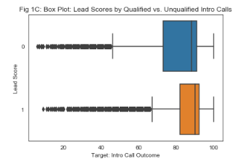
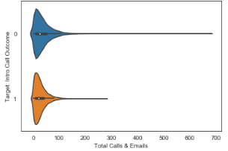
IV. Exploratory Analysis
After data cleaning and processing I then analyzed a sample of potential key drivers of call qualifications. They included:
inferScore___Lead_AddedInfo ***
totalEMails___Lead_AddedInfo
totalCalls___Lead_AddedInfo ***
introCallCreated_leadCreated_delta ***
assignedToRole___IntroCall_OtherInfo_map
country___Lead_LeadCompanyInformation_map
trafficChannel___Lead_MarketingInformation_map_map
product2___IntroCall_MeetingDetails_WalkMe
Features that seemed particularly promising ***

Slide 7
IV. Feature Engineering & Selection
Feature Selection:
Of the available 108 columns (Leads) & 115 columns (Intro Calls), 37 fields were used.
Fields of high interest included:
inferScore___Lead_AddedInfo
totalEMails___Lead_AddedInfo
totalCalls___Lead_AddedInfo
introCallCreated_leadCreated_delta
assignedToRole___IntroCall_OtherInfo_map
country___Lead_LeadCompanyInformation_map
trafficChannel___Lead_MarketingInformation_map_map
product2___IntroCall_MeetingDetails_WalkMe
Feature Engineering performed:
Remapping of picklist values to cleaned dictionaries
Standardization of datetime fields
Model Process:
Prepare master data set (1-Hot Encoding)
Scale data (StandardScaler)
Train-Test-Split data
Evaluate
Tune parameters using RandomizedSearchCV & GridSearchCV
Evaluate

Slide 8
V. Model Selection + Performance
Decided to use some of the classic machine learning classifiers (Logistic Regression, Random Forest classifier, and a Gradient Boosted Trees)
Best performing model: Random Forest classifier and Gradient Boosted tree models - resulted in an accuracy of 80% with additional hyperparameter tuning.
The top 5 features across all three models in determining Intro Call Qualification Status included:
inferScore___Lead_AddedInfo
totalEMails___Lead_AddedInfo
totalCalls___Lead_AddedInfo
introCallCreated_leadCreated_delta
assignedToRole___IntroCall_OtherInfo_map
The features I assumed would be highly ranked but weren’t included:
country___Lead_LeadCompanyInformation_map
trafficChannel___Lead_MarketingInformation_map_map
product2___IntroCall_MeetingDetails_WalkMe
Model | Performance | Performance with Param. Tuning | Optimal Params
Logistic Regression | 73% | 73% | {'C': 1, 'max_iter': 100}
Random Forest | 74% | 80% | {'bootstrap': False, 'max_depth': 60, 'max_features': 'sqrt', 'min_samples_leaf': 1, 'min_samples_split': 10, 'n_estimators': 400}
Gradient Boosted Tree | 78% | 80% | {'colsample_bytree': 1.0, 'gamma': 1, 'max_depth': 6, 'min_child_weight': 9, 'subsample': 1.0}

Slide 9
VI. Take-Aways
Biggest takeaways from the project given the feature ranking & exploratory analysis:
Quality of lead can continue to impact downstream qualification & sales process beyond the Marketing to Sales Handoff, with lead scores differing between Qualified & Not Qualified Intro Calls (Lead Score).
Level of engagement can be an important indicator of a qualified prospect & can show inefficiencies in engagements with not qualified prospects (Total Calls + Emails).
Freshness of lead doesn’t seem to impact outcome (Lead to Intro Call Creation Delta).
Given the results of the models and tests, my project based recommendations are:
Given that disqualified intro calls were correlated with higher calls & emails, one possible suggestion could be to train the sales teams to front load discovery questions for earlier disqualification.
Given also the difference in distributions of lead scores by qualified vs. disqualified, there could be downstream impact from marketing letting in poorer quality leads. Some of their assertions should also be evaluated as it seems their leads aren’t as high quality as expected.

Slide 10
A1. Appendix: Additional Resources
Project Page:
List of resources (& links) used for the project: https://bit.ly/2T0kmxC
Project Repo:
Jupyter notebook:
Supporting Documentation:
Presentation deck:
Springboard Program:
Information about program: https://www.springboard.com/workshops/data-science-career-track/

Slide 11
A2. Appendix: About me
Applied analytics and data science evangelist, Mikiko Bazeley is a seasoned analyst with 5+ years of working in high-impact roles for start-ups and enterprise tech companies.
A UCSD Economics & Anthropology graduate, Mikiko aims to use her experience in social research & modeling to strategically leverage data science in order to drive new insights for sales, marketing, finance & customer success organizations. Mikiko is also GIS & Supply Chain Management certified.
Prior to joining WalkMe (where she focuses on scaling data science & global sales analytics) Mikiko worked as a Data Scientist at Autodesk (focused on understanding product adoption & user health), as well as assisting with scaling strategic finance initiatives at Sunrun (the largest residential solar company in the US).
Please feel free to reach out:
LinkedIn: https://www.linkedin.com/in/mikikobazeley/
Email: mmbazel (at) gmail (dot) com

Slide 12
Thanks!

